Slide 1
CQRS: Command / Query Responsibility Segregation
A scalable pattern for building large multi-user system
Brian Ritchie
Chief Architect PaySpan, Inc.
Twitter: @brian_ritchie
Email: brian.ritchie@gmail.com
Blog: http://weblog.asp.net/britchie
Web: http://www.dotnetpowered.com

Slide 2
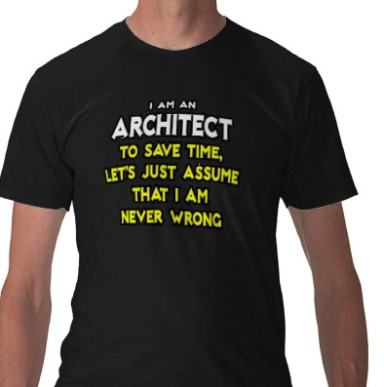
Who am I?
Brian Ritchie
Chief Architect at PaySpan, Inc.
Nearly 20 years of development experience
Developing on .NET since 1.0 Beta 1
Contributed to Mono and other open source projects

Slide 3
CQRS
Agenda
What is CQRS anyway?
Why is it needed?
How does CQRS work?
When should I use CQRS?
Review example implementation

Slide 4
So what is CQRS?
According to Wikipedia:
"CQRS is simply the creation of two objects where there was previously only one. The separation occurs based upon whether the methods are a command or a query (the same definition that is used by Meyer in Command and Query Separation, a command is any method that mutates state and a query is any method that returns a value)."

Slide 5

So what is CQRS?
Say what?

Slide 6
So what is CQRS?
Put another way…
Command/Query Responsibility Segregation (CQRS) is the idea that you can use a different model to update information than the model you use to read information.
In this context,
Commands = Writes
Queries = Reads
Pioneered by Greg Young & Udi Dahan

Slide 7

Ok, got it….
But why?

Slide 8
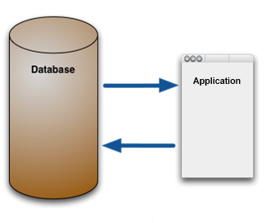


Why is CQRS needed?
Let’s take a step back. Why do we build applications like we do today?
It started with a stack of paper…
…that needed to be keyed into the machine
…and along came
the CRUD app!

Slide 9
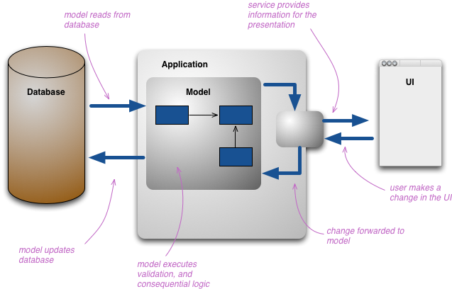
Why is CQRS needed?
Being good developers, we didn’t stop there. We built various models to protect us from change at different layers of the application.
Diagram © Martin Fowler

Slide 10
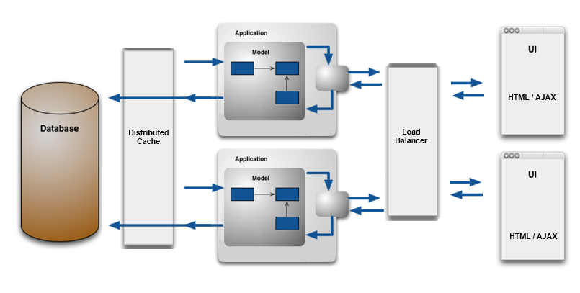
Why is CQRS needed?
But this wasn’t scalable…so we add more layers.
Not only did we add layers, but also complexity.

Slide 11
Why is CQRS needed?
All of this to provide scalability & a consistent view of the data.
But did we succeed?

Slide 12
Why is CQRS needed?
Back to our CRUD app…
?
?
?
?
?
?
Where is the consistency? We have stale data all over the place!

Slide 13

Why is CQRS needed?
To understand this better, let’s look at a basic multi-user system.
Retrieve data
Retrieve data
User is looking at stale data
Modify data
Stale data is inherent in a multi-user system.
The machine is now the source of truth…not a piece of paper.

Slide 14
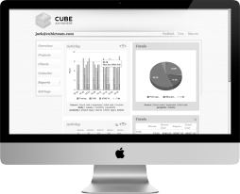
Why is CQRS needed?
Which begs the question…
Is the data the user is looking at right now stale?
Absolutely!

Slide 15

Why is CQRS needed?
Since stale data always exists, is all of this complexity really needed to scale?
No, we need a different approach.
One that…
Offers extreme scalability
Inherently handle multiple users
Can grow to handle complex problems without growing development costs

Slide 16
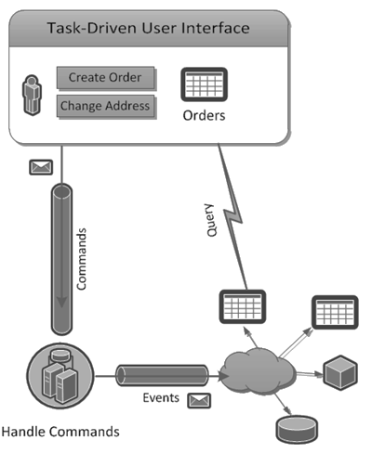
How does CQRS work?
Which brings us back to CQRS…
Command captures the intent of the user
Scale out as many copies as needed
Persistent View Model schema matches UI view model
After database is updated, publish result to view model
Diagram from Rinat Abdullin
http://abdullin.com/cqrs
A queue can be utilized to optimize write performance

Slide 17
How does CQRS work?
Let’s break it down…
Common components of the CQRS pattern:
Task-based UI
Commands
Domain Objects
Events
Persistent View Model
Note: these are common components…not required components

Slide 18
How does CQRS work?
Task-based UI

Slide 19
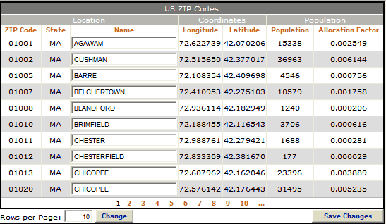
How does CQRS work?
Task-based UI
Why rethink the User Interface?
Grids don’t capture the user’s intent

Slide 20
How does CQRS work?
Task-based UI
Rethinking the User Interface
Adjust UI design to capture intent
what did the user really mean?
intent becomes a command
Why is intent important?
Last name changed because of misspelling
Last name changed because of marriage
Last name changed because of divorce
User interface can affect your architecture

Slide 21
How does CQRS work?
Task-based UI
Validation
increase likelihood of command succeeding
validate client-side
optimize validation using persistent view model
What about user feedback?
Polling: wait until read model is updated
Use asynchronous messaging such as email
“Your request is being processed. You will receive an email when it is completed”
Just fake it!
Scope the change to the current user. Update a local in-memory model

Slide 22
How does CQRS work?
Commands

Slide 23
How does CQRS work?
Commands
Commands encapsulate the user’s intent but do not contain business logic, only enough data for the command
What makes a good command?
A command is an action – starts with a verb
The kind you can reply with: “Thank you. Your confirmation email will arrive shortly”. Inherently asynchronous.
Commands can be considered messages
Messaging provides an asynchronous delivery mechanism for the commands. As a message, it can be routed, queued, and transformed all independent of the sender & receiver

Slide 24
How does CQRS work?
Commands & Domain Objects
The domain model is utilized for processing commands; it is unnecessary for queries.
Unlike entity objects you may be used to, aggregate roots in CQRS only have methods (no getters/setters)
Aggregate Roots
Some things belong together, like Apple Pie and Ice Cream, or Sonny and Cher. And so it is with Entities and Value Objects (VOs) – some of them belong together. Aggregates are groups of things that belong together. An Aggregate Root is the thing that holds them all together.
Example: OrderLines have no reason to exist without their parent Order, nor can they belong to any other Order. In this case, Order and OrderLines would be an Aggregate, and the Order would be the Aggregate Root

Slide 25
How does CQRS work?
Commands & Domain Objects
Setters are an anti pattern in your domain. DDD is not about modeling data, or nouns. It is about modeling behaviors that are solving the domain problem, or verbs.
The public interface of your domain should solely consist in public methods on your aggregate roots. The idea is that each method represents a use case.
From a design perspective, it is also the only way to ensure your objects invariants. That way, your aggregates are always fully consistent – they valid state at all times.
If DDD is about behavior, then getters also should be an anti pattern. And they are.
Julienn Letrouit http://julienletrouit.com/?p=22

Slide 26
How does CQRS work?
Events

Slide 27
How does CQRS work?
Events
Events describe changes in the system state
An Event Bus can be utilized to dispatch events to subscribers
Events primary purpose update the read model
Events can also provider integration with external systems
CQRS can also be used in conjunction with Event Sourcing.
Event Sourcing
Captures all changes to an application state as a sequence of events. The current state is constructed by applying the events in the order they were recorded. Not only does it give us the current state, but we can also use the event log to reconstruct past states, and as a foundation to automatically adjust the state to cope with retroactive changes.
Summarized from Martin Fowler – http://martinfowler.com/eaaDev/EventSourcing.html

Slide 28
How does CQRS work?
Persistent View Model

Slide 29
How does CQRS work?
Persistent View Model
Reads are usually the most common activity – many times 80-90%. Why not optimize them?
Read model is based on how the user wants to see the data.
Read model can be denormalized RDBMS, document store, etc.
Reads from the view model don’t need to be loaded into the domain model, they can be bond directly to the UI.

Slide 30
How does CQRS work?
Persistent View Model
UI
Query only…keep it simple
Persistent View Model
For each view in the UI,
have a view/table in the database
SELECT * FROM ViewModelTable (WHERE ID = @ID)

Slide 31
How does CQRS work?
Persistent View Model
Data Duplicated, No Relationships, Data Pre-Calculated
Customer Service Rep view
Supervisor view
List of customers
List of customers
ID Name Phone
ID Name Phone Lifetime value
Rep_Customers_Table
ID | Name | Phone
Supervisor_Customers_Table
ID | Name | Phone | Lifetime Value

Slide 32
When should I use CQRS?
First off, when should I avoid it?
CQRS can be overkill for simple applications.
Don’t use it in a non-collaborative domain or where you can horizontally add more database servers to support more users/requests/data at the same time you’re adding web servers – there is no real scalability problem – Udi Dahan

Slide 33
When should I use CQRS?
CQRS is a pattern that is usually leveraged for a portion of a system.
This builds on a concept from Domain Driven Design (DDD) known as a Bounded Context.
Bounded Context A Bounded Context is an area of your application which has explicitly defined borders, has it’s own model, has it’s own Model, and maintains it’s own code. - Jak Charlton
A Bounded Context can be considered as a miniature application, containing it’s own domain, code and persistence mechanisms. Within a Bounded Context, there should be logical consistency, each Bounded Context should be independent of any other Bounded Context. - ThinkDDD.org
A typical application there are multiple bounded contexts, any of which can be implemented the way it makes sense.

Slide 34
When should I use CQRS?
Guidelines for using CQRS:
Large, multi-user systems CQRS is designed to address concurrency issues.
Scalability matters With CQRS you can achieve great read and write performance. The system intrinsically supports scaling out. By separating read & write operations, each can be optimized.
Difficult business logic CQRS forces you to not mix domain logic and infrastructural operations.
Large or Distributed teams you can split development tasks between different teams with defined interfaces.

Slide 35
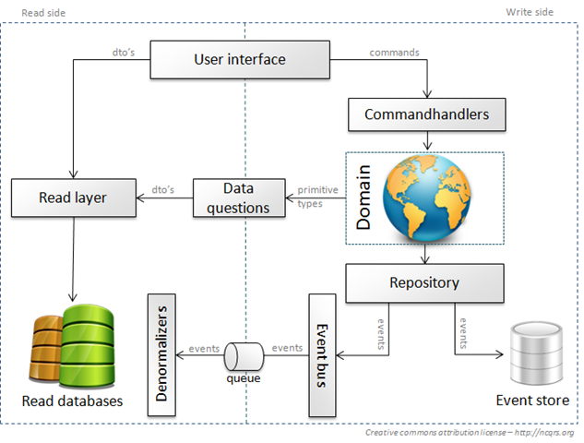
Example implementation- NCQRS

Slide 36
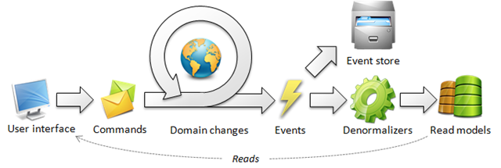
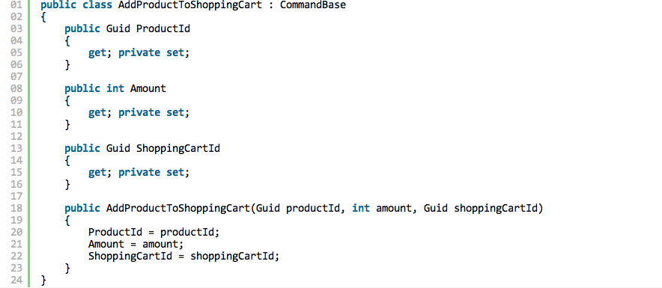
Example implementation- NCQRS
Commands are simple object that contain all the data to perform the underlying action. They also express intent by there name.

Slide 37
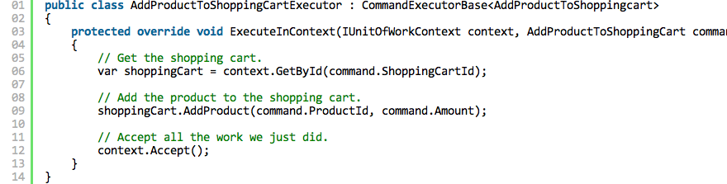
Example implementation- NCQRS
An Command Executors accepts commands of a certain type and performs a corresponding action. The action should not contain business logic and should directly use the domain.

Slide 38
Example implementation- NCQRS
All events that have occurred end up in the event store. It contains all the event that represents the state changes in the system. These can be used to build up the current state by replaying them all. This store can also be used to fill up new or repair existing read model.
For the event store, NCQRS supports MSSQL, MongoDB, RavenDB, SqlLite, and more…

Slide 39
Example implementation- NCQRS
NCQRS provides a base class for denormalizers that allows them
to be subscribed to the event bus.

Slide 40
Command / Query Responsibility Segregation
CQRS
A scalable pattern for building large multi-user system
Questions?
Brian Ritchie
Chief Architect PaySpan, Inc.
Twitter : @brian_ritchie
Email: brian.ritchie@gmail.com
Blog: http://weblog.asp.net/britchie
Web: http://www.dotnetpowered.com

Slide 41
Command / Query Responsibility Segregation
CQRS
A scalable pattern for building large multi-user system
Thank you!
Brian Ritchie
Chief Architect PaySpan, Inc.
Twitter : @brian_ritchie
Email: brian.ritchie@gmail.com
Blog: http://weblog.asp.net/britchie
Web: http://www.dotnetpowered.com

